Slide 1
COMP4901K/Math4824B Machine Learning for Natural Language Processing
Lecture 24: Machine Learning For NLP:
Past, Present, and Future
Instructor: Yangqiu Song
Slides credits: Richard Socher, Percy Liang, Yejin Choi, Dawn Song

Slide 2
Levels of Linguistic Analysis
Pragmatics: what does it do?
implemented the
right algorithm
Semantics: what does it mean?
no implementation bugs
Syntax: what is grammatical?
no compiler errors
Morphology: basic unit of words
naming your world

Slide 3
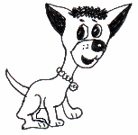
An example of NLP
A dog is chasing a boy on the playground.
Det
Noun
Aux
Verb
Det
Noun
Prep
Det
Noun
Lexical
analysis
(part-of-speech
tagging)
Noun Phrase
Noun Phrase
Complex Verb
Noun Phrase
Semantic analysis
Prep Phrase
Dog(d1).
Boy(b1).
Playground(p1).
Chasing(d1,b1,p1).
Verb Phrase
Syntactic analysis
(Parsing)
Verb Phrase
+
Sentence
Scared(x) if Chasing(_,x,_).
A person saying this may
be reminding another person to get the dog back…
Scared(b1)
Inference
Pragmatic analysis
(speech act)

Slide 4
Machine learning for NLP
mid-1970s: HMMs for speech recognition → probabilistic models
early 2000s: conditional random fields for part-of-speech tagging → structured prediction
early 2000s: Latent Dirichlet Allocation for modeling text documents → topic modeling
mid 2010s: sequence-to-sequence models for machine translation → neural networks with memory/state
We only selected some of the important topics

Slide 5
The state of the art
A dog is chasing a boy on the playground
POS
Tagging:
97%
Det
Noun
Aux
Verb
Det
Noun
Prep
Det
Noun
Noun Phrase
Noun Phrase
Complex Verb
Noun Phrase
Prep Phrase
Verb Phrase
Parsing: partial >90%
Semantics: some aspects
Entity/relation extraction
Word sense disambiguation
Anaphora resolution
Verb Phrase
Sentence
Inference: ???
Speech act analysis: ???

Slide 6
What has been lost from old NLP work?
An earlier era of work had lofty goals, but modest realities
Today, we have much better realities, but often content ourselves with running LSTMs rather than reaching for the stars

Slide 7
What didn’t work?
Adversarial examples
Commonsense knowledge
Grounding and meaning related to the real world

Slide 8
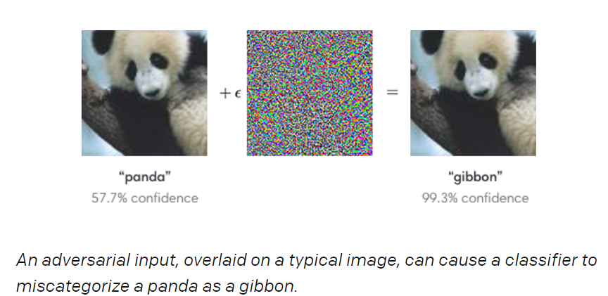
Attacking Machine Learning with Adversarial Examples
https://blog.openai.com/adversarial-example-research/

Slide 9
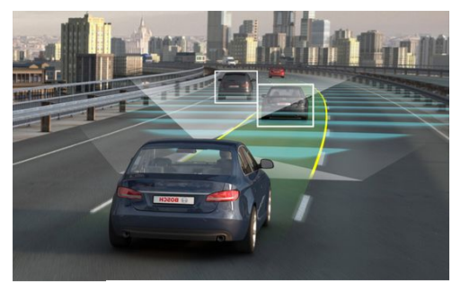
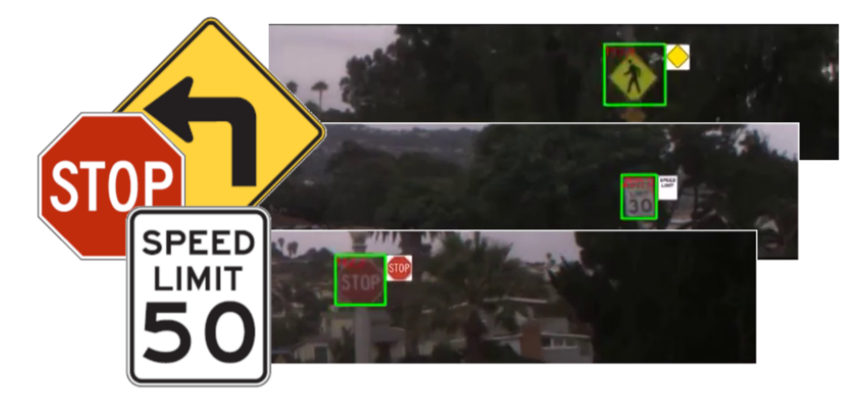
Attacking Machine Learning with Adversarial Examples
https://seclab.stanford.edu/AdvML2017/slides/dawn-stanford-ai-security-workshop-short-sep-2017.pdf

Slide 10
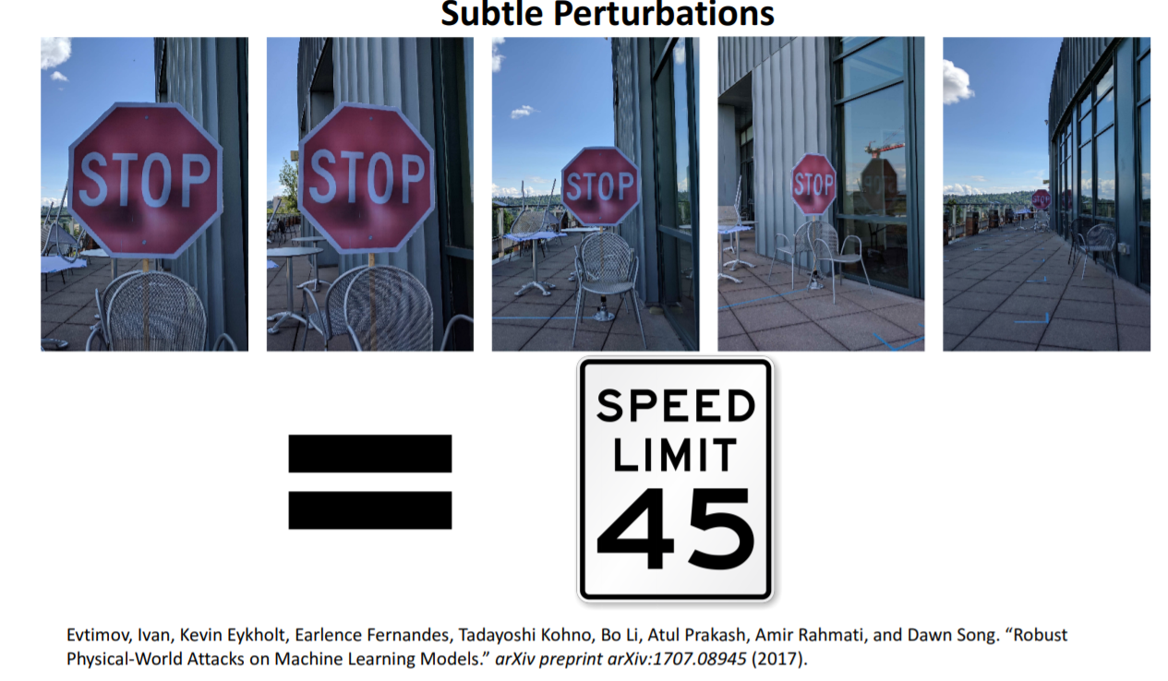
Attacking Machine Learning with Adversarial Examples
https://seclab.stanford.edu/AdvML2017/slides/dawn-stanford-ai-security-workshop-short-sep-2017.pdf

Slide 11
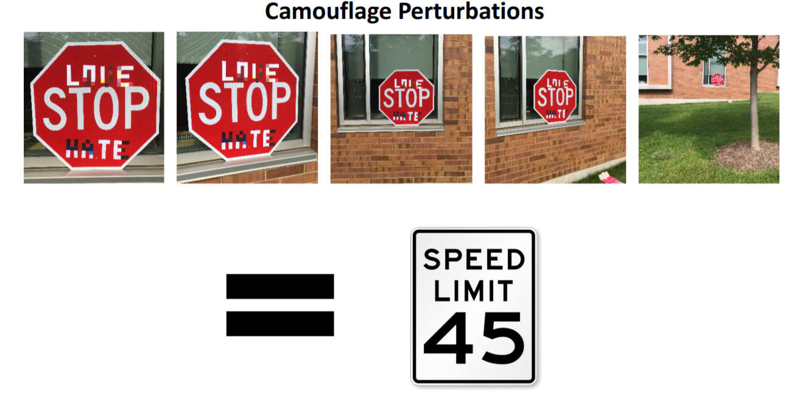
Attacking Machine Learning with Adversarial Examples
https://seclab.stanford.edu/AdvML2017/slides/dawn-stanford-ai-security-workshop-short-sep-2017.pdf

Slide 12
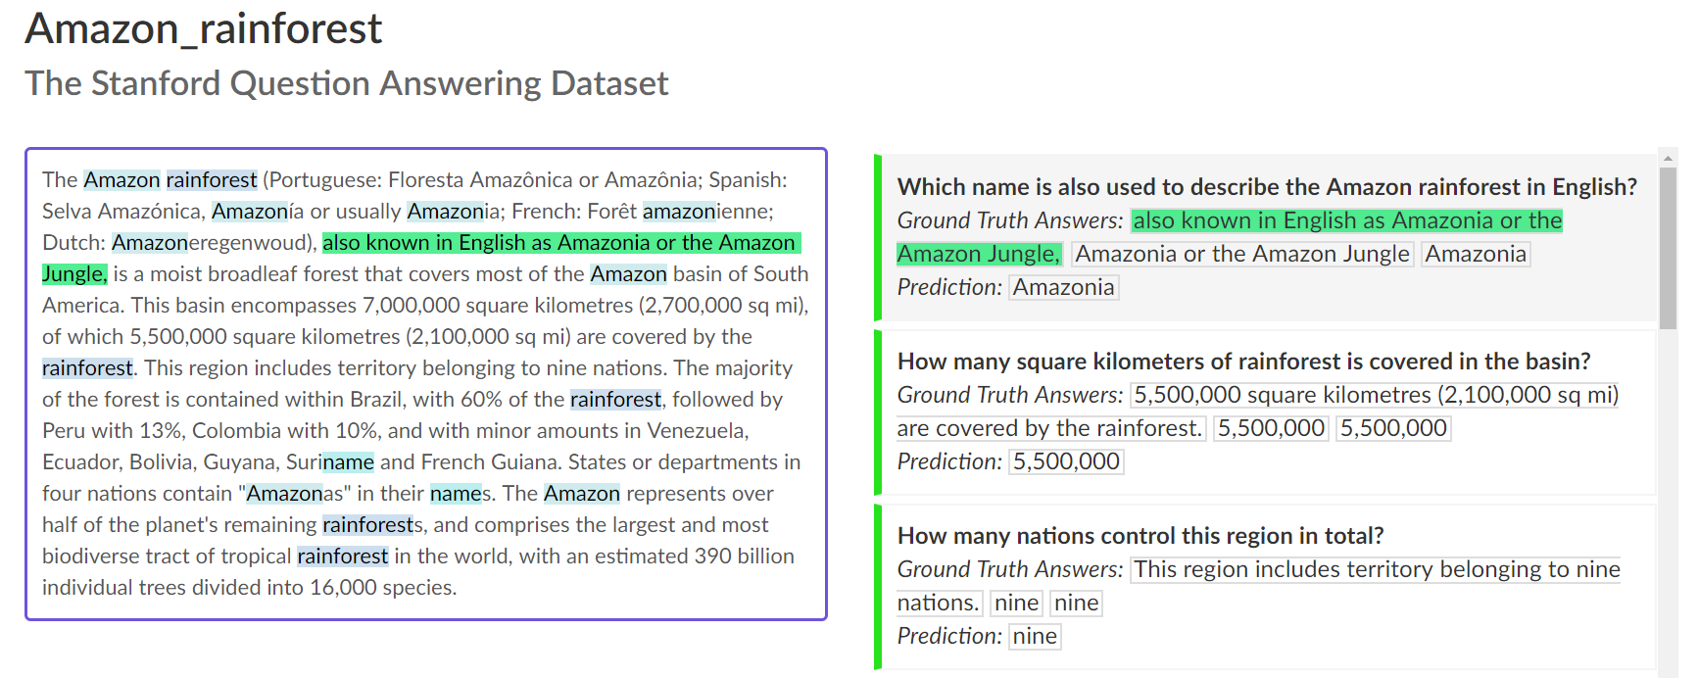
https://rajpurkar.github.io/SQuAD-explorer/

Slide 13
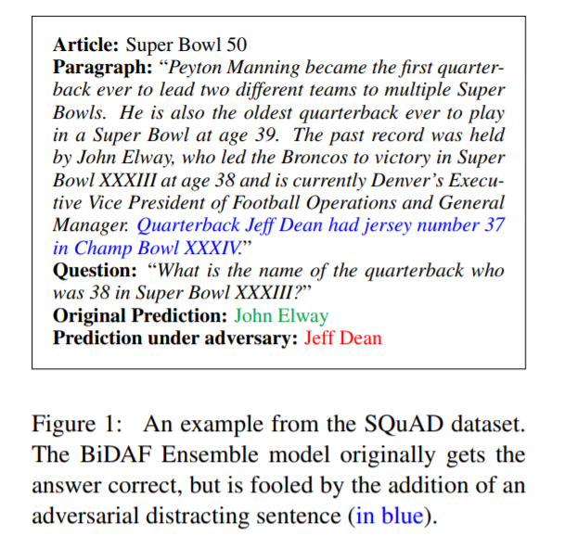
Attacking Machine Learning with Adversarial Examples
Context of the new sentence may indicate that the answer is inside it.
https://arxiv.org/pdf/1707.07328.pdf

Slide 14
What didn’t work?
Adversarial examples
Commonsense knowledge
Grounding and meaning related to the real world

Slide 15
Pragmatics
Semantics: what does it mean literally?
Pragmatics: what is the speaker really conveying?
Conversational implicature (two speakers are saying something within context. Seeing the dialogue only misses information embedded in the context.)
A: What on earth has happened to the roast beef?
B: The dog is looking very happy.
Implicature: The dog at the roast beef.
Presupposition: background assumption independent of truth of sentence
I have stopped eating meat.
Presupposition: I once was eating meat.

Slide 16
“Commonsense Knowledge”
When we communicate,
we omit a lot of “common sense” knowledge, which we assume the hearer/reader possesses
we keep a lot of ambiguities, which we assume the hearer/reader knows how to resolve

Slide 17
What is Commonsense Knowledge?
Knowledge about the everyday world that is possessed by all people
A lemon is sour.
To open a door, you must usually first turn the doorknob.
If you forget someone’s birthday, they may be unhappy with you.

Slide 18
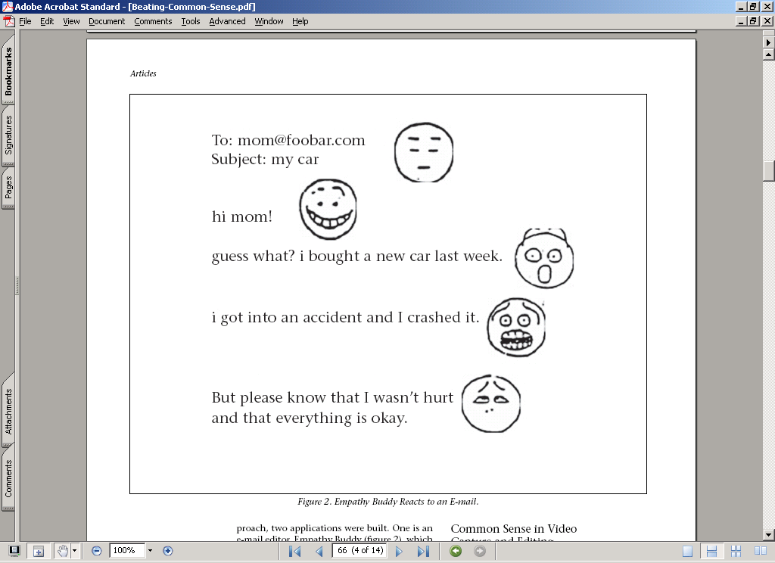
Detecting Moods (“affect”) in Text

Slide 19
Reading between the Lines
Someone stabbed a cheeseburger?
A cheeseburger stabbed someone?
A cheeseburger stabbed another cheeseburger?
Someone stabbed someone else over a cheeseburger?

Slide 20
Reading between the Lines What’s not said?
Physical Commonsense: not possible to stab using a burger
Social Commonsense: stabbing someone is bad

Slide 21
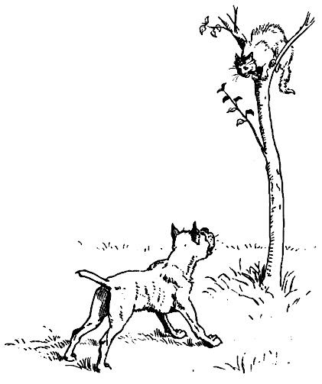
Winograd Challenge (Levesque et al., 2014)
The dog chased the cat, which ran up a tree. It waited at the top.
The dog chased the cat, which ran up a tree. It waited at the bottom.

Slide 22
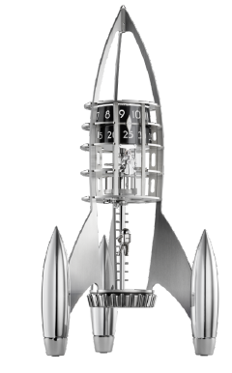
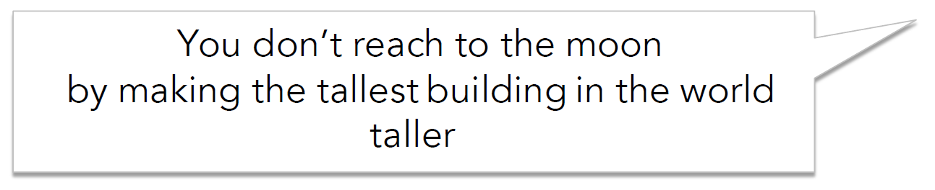
Don’t large-scale LMs learn commonsense?
Recent GoobleBrain results on Winograd Schema:
BiLSTM = 63.7%
The best BERT = 65.1%
https://gluebenchmark.com/leaderboard

Slide 23
What didn’t work?
Adversarial examples
Commonsense knowledge
Grounding and meaning related to the real world

Slide 24
The Missing Representation in Neural (Language) Models

Slide 25
Today “neural” NLG depends less on NLU
Pre-DL, NLG models often started with NLU output.
Post-DL, NLG seems less dependent on NLU.
What brought significant improvements in NLG recent years isn’t so much due to better NLU (tagging, parsing, co-ref, QA)
In part because end-to-end models work better than pipeline models.
It’s just seq-2-seq with attention!

Slide 26
NLG depends heavily on Neural-LMs
Conditional models:
Sequence-to-sequence models
Generative models:
Language models
Works amazingly well for
MT, speech recognition,
image captioning, …

Slide 27
however, neural generation can be brittle

Slide 28
Neural generation can be brittle (no adversary necessary)
All in all, I would highly recommend this hotel to anyone who wants to be in the heart of the action, and want to be in the heart of the action. If you want to be in the heart of the action, this is not the place for you. However, If you want to be in the middle of the action, this is the place to be.
GRU Language Model trained on TripAdvisor (350 million words) decoded with Beam Search.

Slide 29
Neural generation can be brittle (no adversary necessary)
All in all, I would highly recommend this hotel to anyone who wants to be in the heart of the action, and want to be in the heart of the action. If you want to be in the heart of the action, this is not the place for you. However, If you want to be in the middle of the action, this is the place to be.
Repetition
GRU Language Model trained on TripAdvisor (350 million words) decoded with Beam Search.

Slide 30
Neural generation can be brittle (no adversary necessary)
All in all, I would highly recommend this hotel to anyone who wants to be in the heart of the action, and want to be in the heart of the action. If you want to be in the heart of the action, this is not the place for you. However, If you want to be in the middle of the action, this is the place to be.
Contradictions
GRU Language Model trained on TripAdvisor (350 million words) decoded with Beam Search.

Slide 31
Neural generation can be brittle (no adversary necessary)
All in all, I would highly recommend this hotel to anyone who wants to be in the heart of the action, and want to be in the heart of the action. If you want to be in the heart of the action, this is not the place for you. However, If you want to be in the middle of the action, this is the place to be.
Generic, bland, lack of details
GRU Language Model trained on TripAdvisor (350 million words) decoded with Beam Search.

Slide 32
Natural language in, unnatural language out. why?
Not enough depth?
Not enough data?
Not enough GPUs?
Even with more depth, data, GPUs, I’ll speculate that current LM variants are not sufficient for robust NLG
We probably need NLU
To identify the semantic meanings of words, entities, relations, and events
To ground to the physical world or to a knowledge base

Slide 33
Organizing knowledge
It’s a version of Chicago – the standard classic Macintosh menu font, with that distinctive thick diagonal in the ”N”.
Chicago was used by default for Mac menus through MacOS 7.6, and OS 8 was released mid-1997..
Chicago VIII was one of the early 70s-era Chicago albums to catch my
ear, along with Chicago II.

Slide 34
Cross-document co-reference resolution
It’s a version of Chicago – the standard classic Macintosh menu font, with that distinctive thick diagonal in the ”N”.
Chicago was used by default for Mac menus through MacOS 7.6, and OS 8 was released mid-1997..
Chicago VIII was one of the early 70s-era Chicago albums to catch my
ear, along with Chicago II.

Slide 35



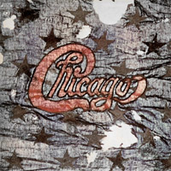
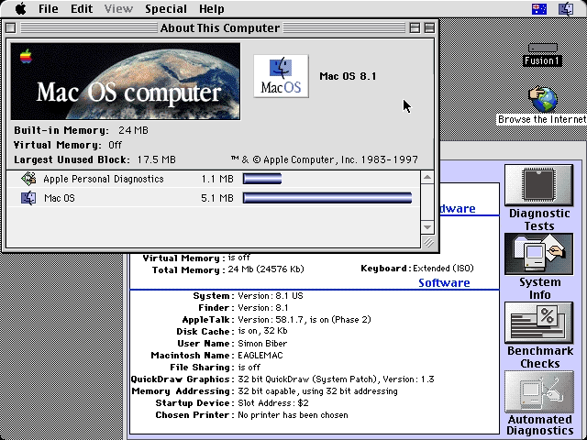
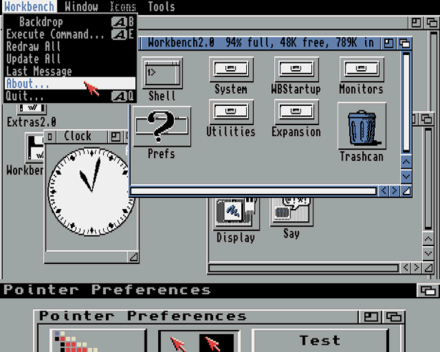
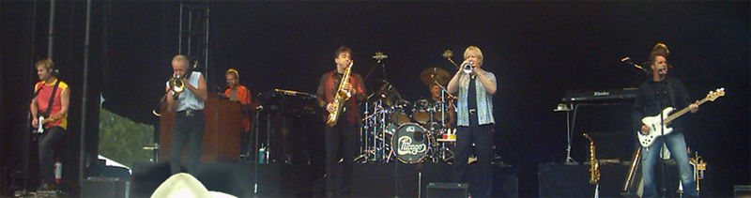
Reference resolution: (disambiguation to Wikipedia)
It’s a version of Chicago – the standard classic Macintosh menu font, with that distinctive thick diagonal in the ”N”.
Chicago was used by default for Mac menus through MacOS 7.6, and OS 8 was released mid-1997..
Chicago VIII was one of the early 70s-era Chicago albums to catch my
ear, along with Chicago II.

Slide 36
The “Reference” Collection has Structure
It’s a version of Chicago – the standard classic Macintosh menu font, with that distinctive thick diagonal in the ”N”.
Chicago was used by default for Mac menus through MacOS 7.6, and OS 8 was released mid-1997..
Chicago VIII was one of the early 70s-era Chicago albums to catch my
ear, along with Chicago II.
Is_a
Is_a
Used_In
Released
Succeeded

Slide 37
Analysis of Information Networks
It’s a version of Chicago – the standard classic Macintosh menu font, with that distinctive thick diagonal in the ”N”.
Chicago was used by default for Mac menus through MacOS 7.6, and OS 8 was released mid-1997..
Chicago VIII was one of the early 70s-era Chicago albums to catch my
ear, along with Chicago II.

Slide 38

Here – Wikipedia as a knowledge resource …. but we can use other resources
Is_a
Is_a
Used_In
Released
Succeeded

Slide 39



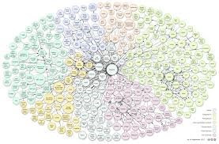


Knowledge graphs
Facebook’s
OpenIE
(
)
Entity Graph
Reverb, OLLIE
Microsoft’s Satori
Google’s Knowledge Graph

Slide 40
Conversational AI with long-term coherence
Grand challenge: 20 minutes
UW (winning) system --- 10+ minutes

Slide 41
System architecture?
sorry, not this kind

Slide 43
How not to win (at least not in 2017)
Brute force more data
Deeper neural networks
with RL

Slide 44
This year (2018) winner’s system (Half million US$)
http://zhouyu.cs.ucdavis.edu/Alexa_Prize_Technical_Article.pdf

Slide 45
An Example Dialog

Slide 46
Topic Distribution of Alexa

Slide 47
Average feedback rating (one to five stars, indicating how likely the user is willing to talk to the system again)

Slide 48
Lots of Other Limits for ML4NLP
Comprehensive QA
Multitask learning
Combined multimodal, logical and memory-based reasoning
Learning from few examples
Still a very active research field

Slide 49
Brief Review for Final Exam
We will have about 10 questions in the final exam
Similar form as Midterm
Sorry there is no example papers since this is the first time offering
We are still working on the final example paper
Date/time: December 12, 8:30AM - 10:30AM
LG4 Student Common Rms, Lift 3

Slide 50
Brief Review for Final Exam
Covering all topics that have not been tested in Midterm
Perceptron
Logistic regression
Multi-layer NN
CNN and RNN
Attention mechanism
Language Models
No calculation with a multi-layer neural network
But perceptron is required
Transformer and BERT will not be included since they are too complicated
But attention model is required

Slide 51
It’s been an exciting semester!
Good luck to the final!
Please fill out SFQ on canvas!
Thank you! ☺

